Slide 1
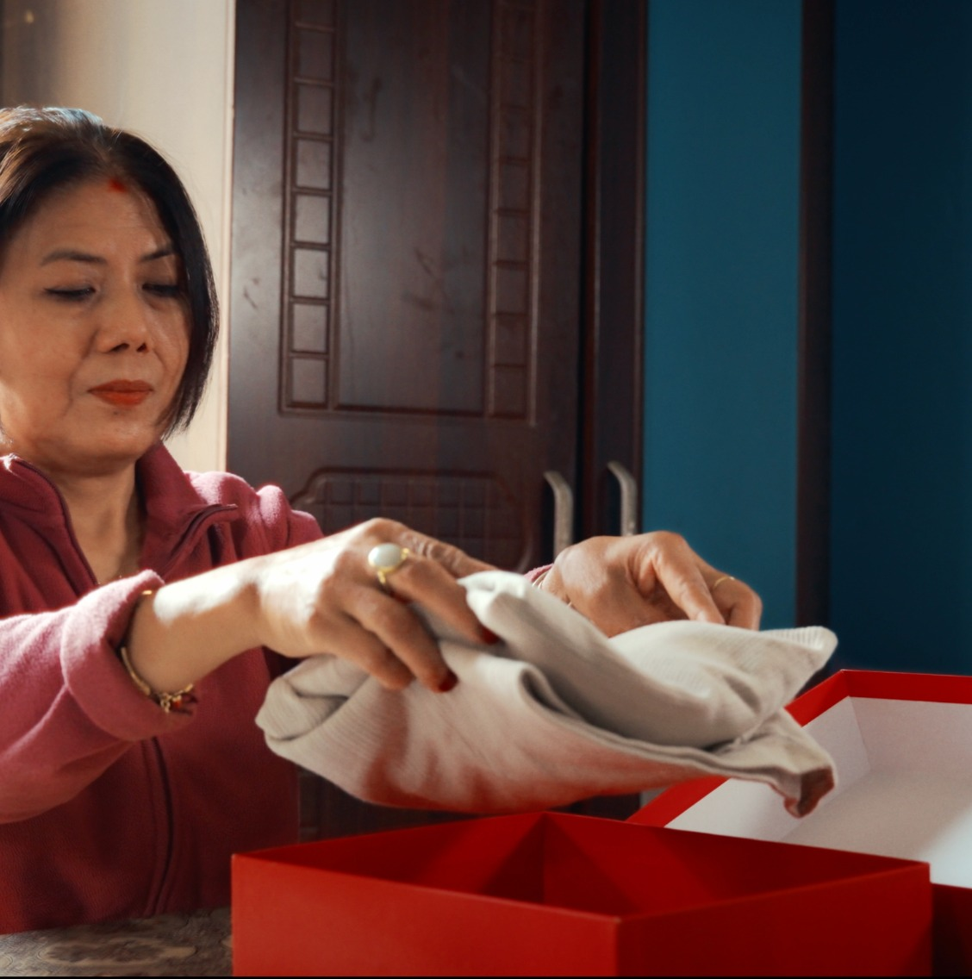
SM6P07NI Digital Media Project
Distance
Doesn’t Matter
Dash Logistics TVC
Individual Presentation • 10 Minutes
Binay Bhattarai
London Met ID: 23048277
SM6P07NI Digital Media Project • Dash Logistics TVC
01

Slide 2
Presentation Roadmap
Built around the coursework criteria: introduction, development process, demonstration and reflection.
01
02
03
Project Introduction
Development Process
Project Demonstration
What the project is, why it was made and the final message.
Research, concept planning, script, storyboard, production and post-production.
Key scenes and final TVC frames showing the emotional delivery journey.
04
05
10 min
Reflection & Critical Analysis
Q&A Preparation
Timing Plan
What worked, what changed, challenges, learning and improvement areas.
Clear answers around process, tools, choices and feedback.
Short visual slides with key talking points for a clear presentation.
SM6P07NI Digital Media Project • Dash Logistics TVC
02

Slide 3
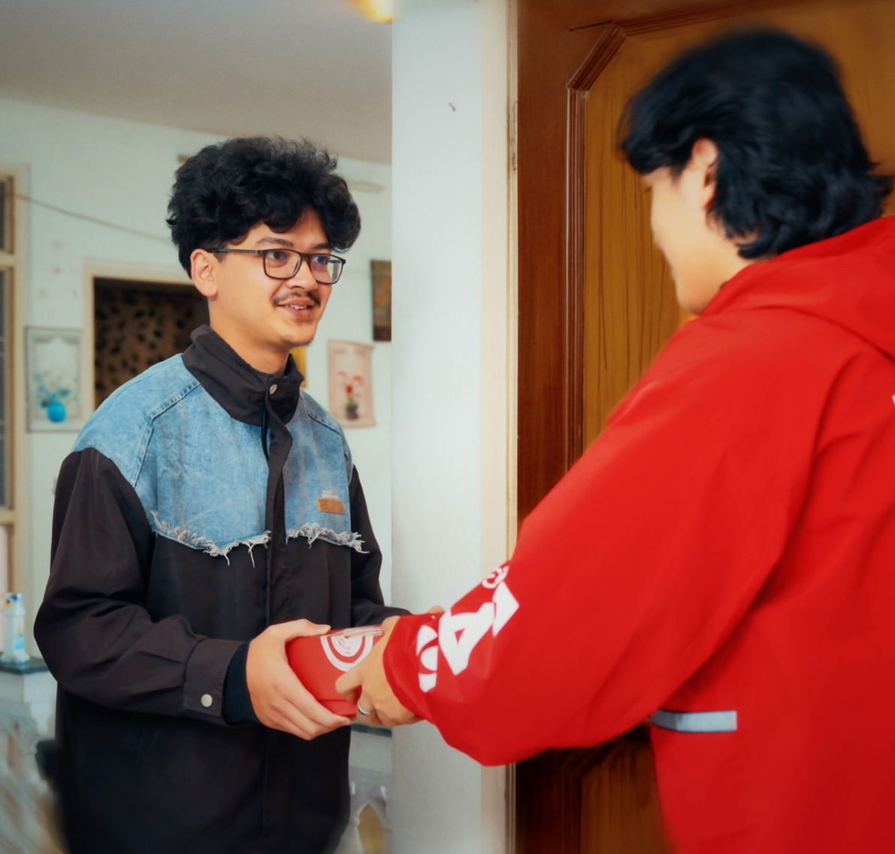
Project Introduction
A no-dialogue emotional TVC for Dash Logistics.
NO DIALOGUE
The TVC tells the story of a mother sending clothes, food and a handwritten note to her son who is living away from home.
Core message
Dash delivers more than parcels — it delivers care, emotion and connection.
Tagline: “Distance doesn’t break bonds. Dash delivers what matters.”
SM6P07NI Digital Media Project • Dash Logistics TVC
03

Slide 4
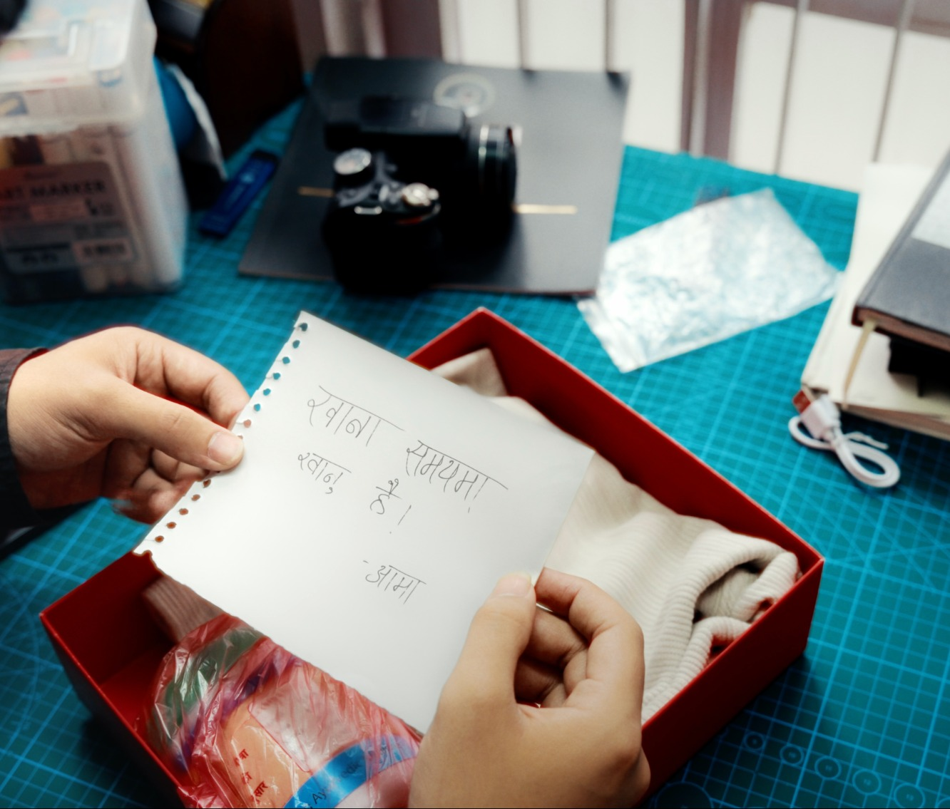
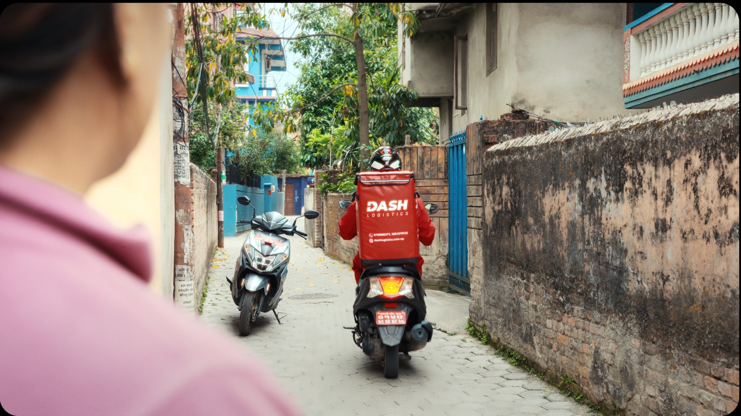
Concept & Story Arc
Simple emotional flow from home to delivery to connection.
1
2
3
4
5
Mother packs
Dash collects
Rider travels
Son receives
Note lands
Care is shown through clothes, food and note.
The package leaves home through the rider.
Scooter journey shows Dash in action.
Distance is reduced through the delivery.
The emotional message completes the story.
SM6P07NI Digital Media Project • Dash Logistics TVC
04

Slide 5
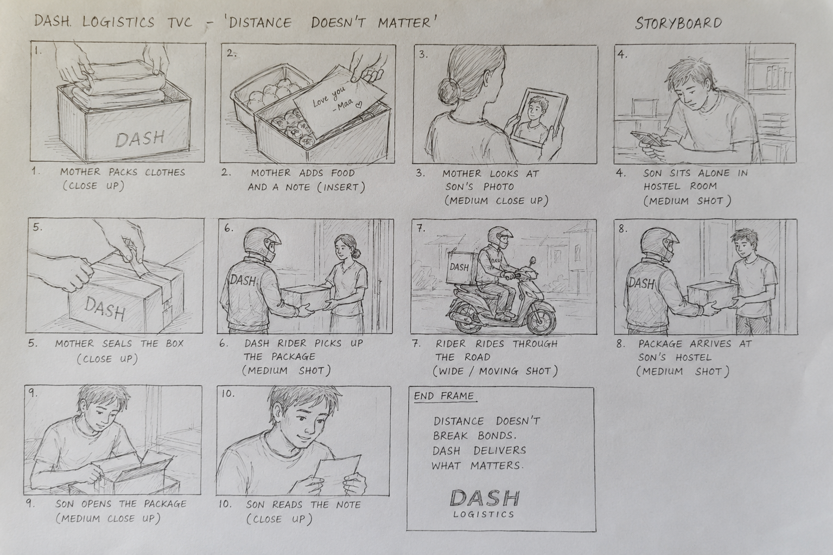
Research & Target Audience
Research focused on how to make a short delivery ad emotionally clear.
Research focus
Emotional storytelling in advertising
Camera movement and shot planning
Lighting, colour tone and visual mood
Sound design for a no-dialogue video
Editing and pacing for story clarity
Target audience
Students, young adults and working people living away from home, plus parents and families who send items to loved ones.
SM6P07NI Digital Media Project • Dash Logistics TVC
05

Slide 6
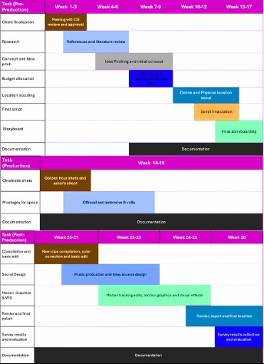
Project Development Process
From concept planning to final export.
01
Research & concept planning
02
Script and storyboard
03
Production shoot
04
DaVinci post-production
05
Testing, feedback and export
The Gantt chart helped organise the work into pre-production, production and post-production so tasks could be followed step by step.
SM6P07NI Digital Media Project • Dash Logistics TVC
06

Slide 7
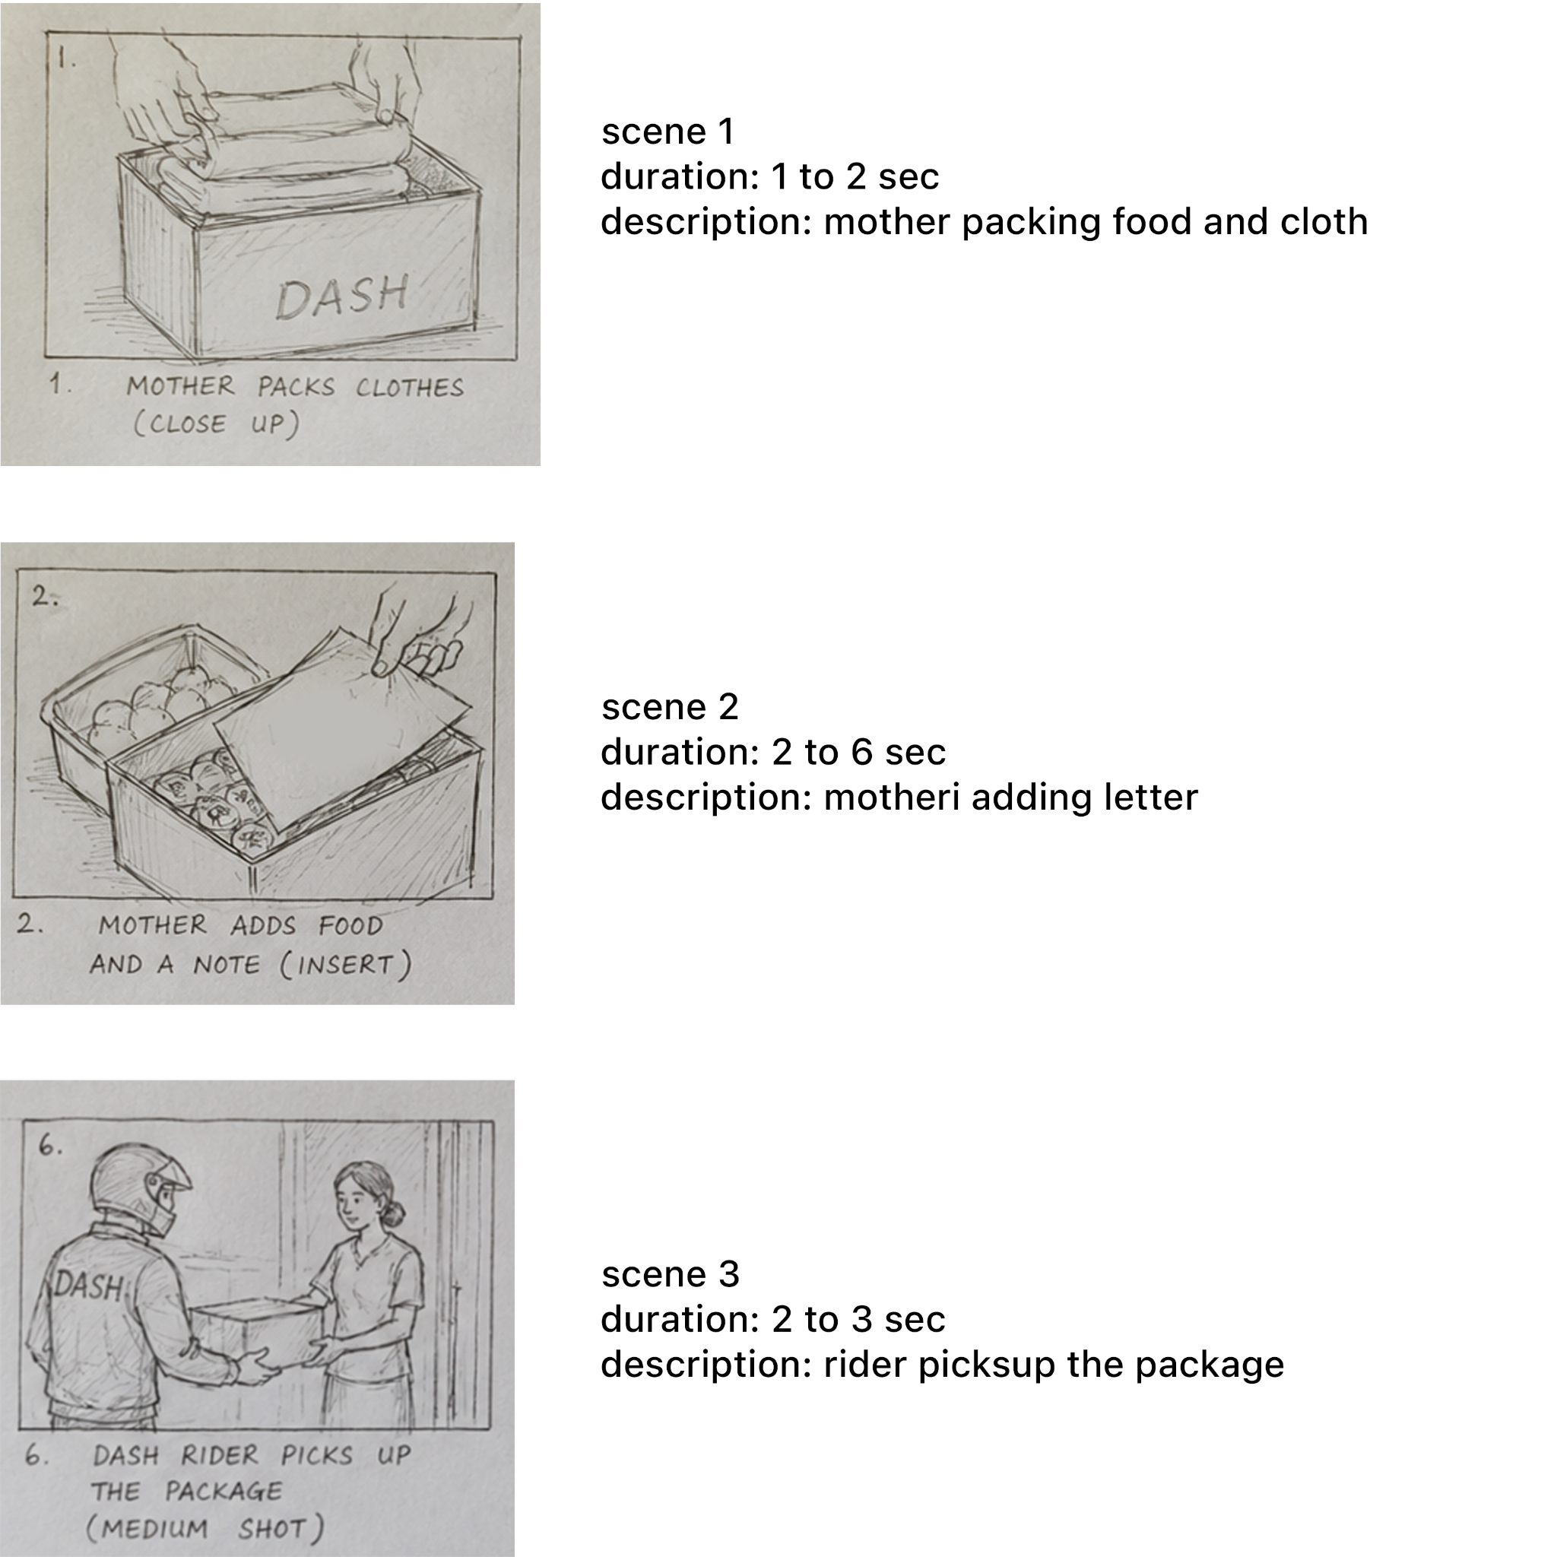
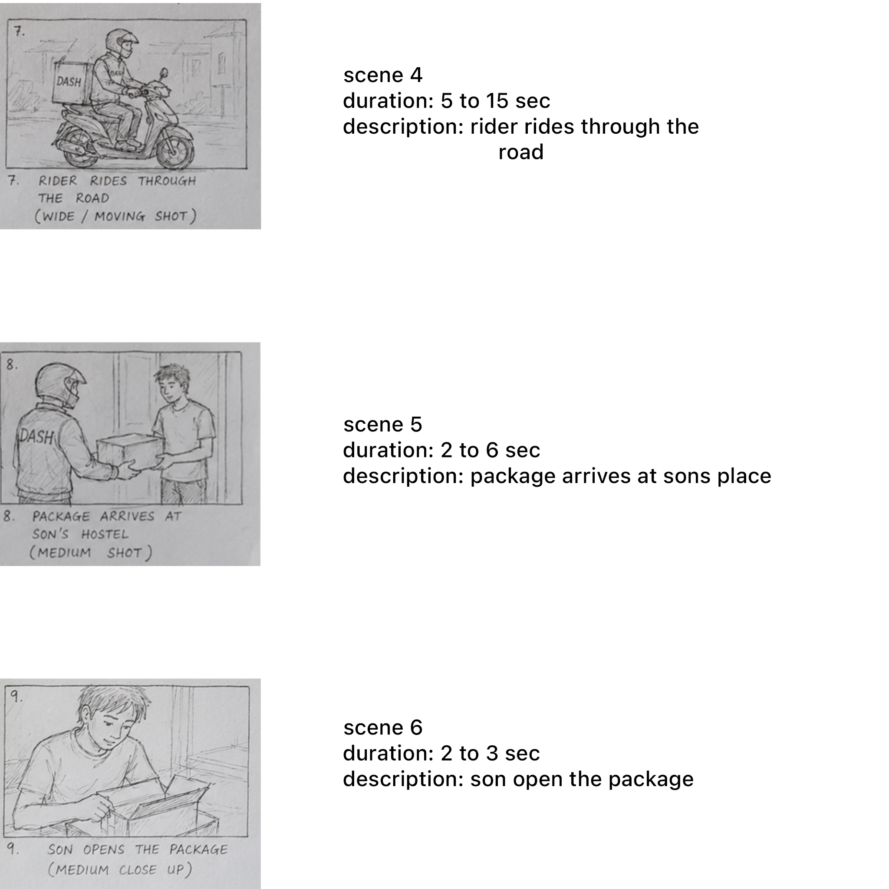
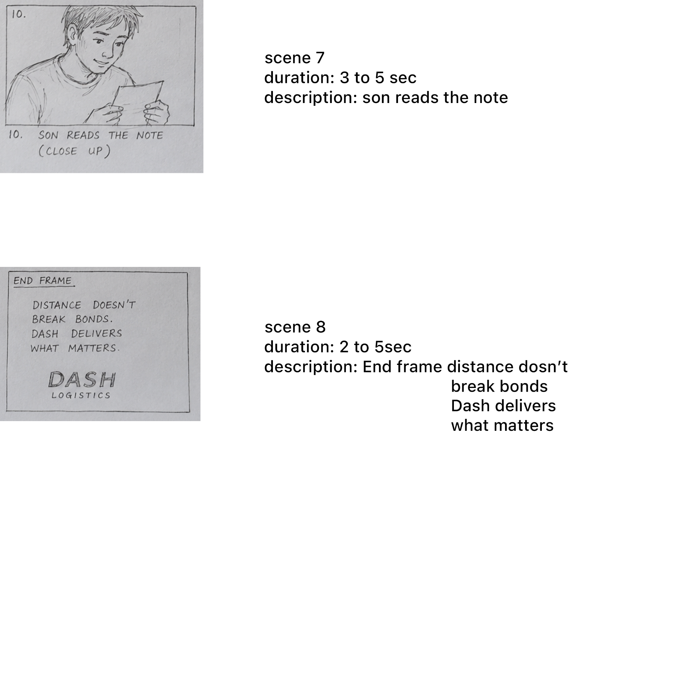
Pre-Production
Planning made the no-dialogue story easier to shoot clearly.
Script + storyboard were used as the main shooting guide.
SM6P07NI Digital Media Project • Dash Logistics TVC
07

Slide 8
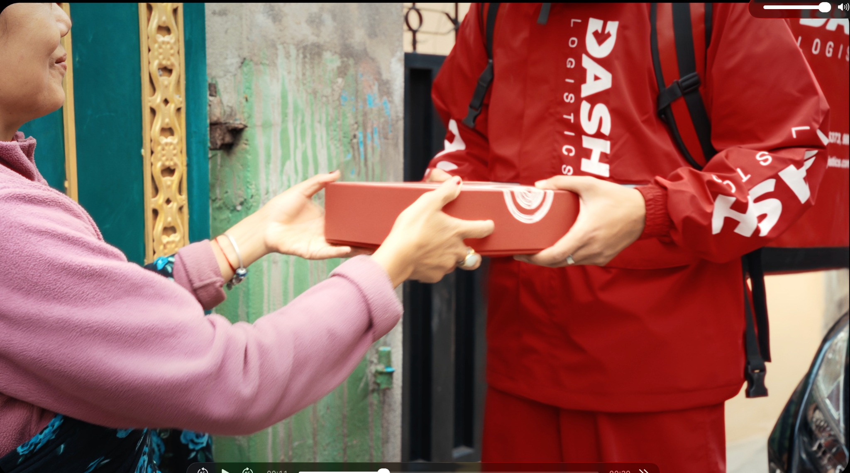
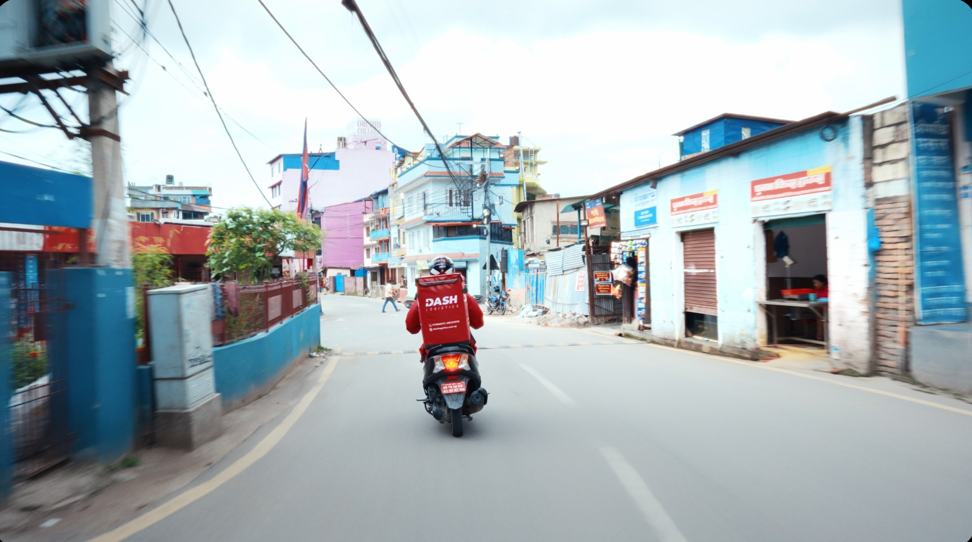
Production Process
Filmed using practical locations and available resources.
Main shoot flow: mother packs → rider collects → scooter delivery → son receives → son reads note.
SM6P07NI Digital Media Project • Dash Logistics TVC
08

Slide 9
Production Resources
Tools and people used to complete the TVC.
Camera
Stability
Sony A7 IV with Sigma 20–70mm lens
K&F Concept tripod and DJI RS4 gimbal
Lighting
Delivery Scene
Natural light, RGB bar light and panel light
Friend’s scooter as Dash vehicle; another scooter for moving shots
Monitoring
Software
iPad A16 used to check frame and focus
DaVinci Resolve for edit, sound, colour and export
SM6P07NI Digital Media Project • Dash Logistics TVC
09

Slide 10
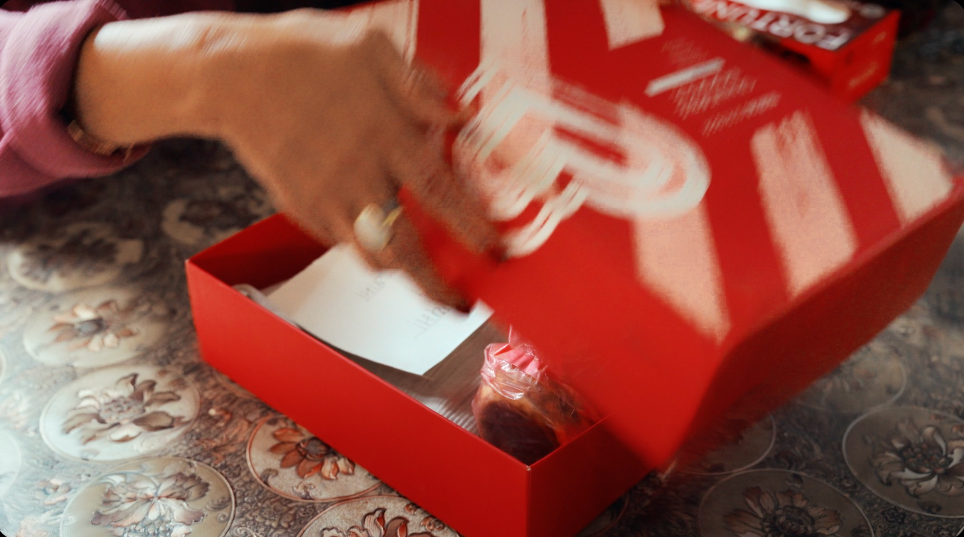
Project Demonstration
Key frames from the final TVC sequence.
These frames show the complete journey: package preparation, rider handover, delivery and emotional note reveal.
SM6P07NI Digital Media Project • Dash Logistics TVC
10

Slide 11
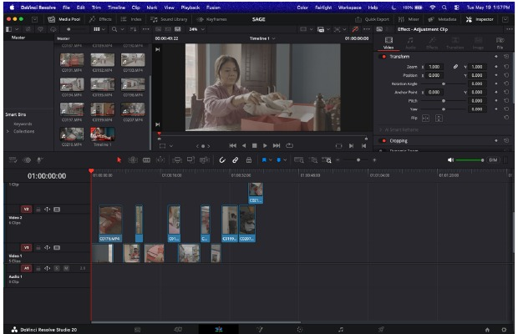
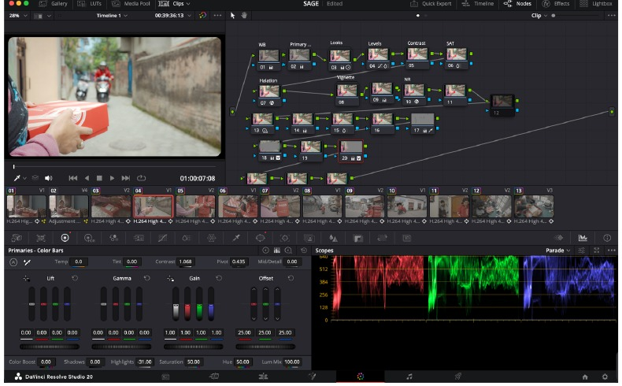
Post-Production in DaVinci Resolve
Editing, sound, colour grading and export were completed in one workflow.
Footage imported and organised by scene
Clips arranged according to the storyboard
Music and natural sounds balanced because there is no dialogue
Colour correction and grading used to keep Dash red strong
Final export prepared for presentation
Final export: H.265 / QuickTime • 3840 × 2160 • 24 fps
SM6P07NI Digital Media Project • Dash Logistics TVC
11

Slide 12
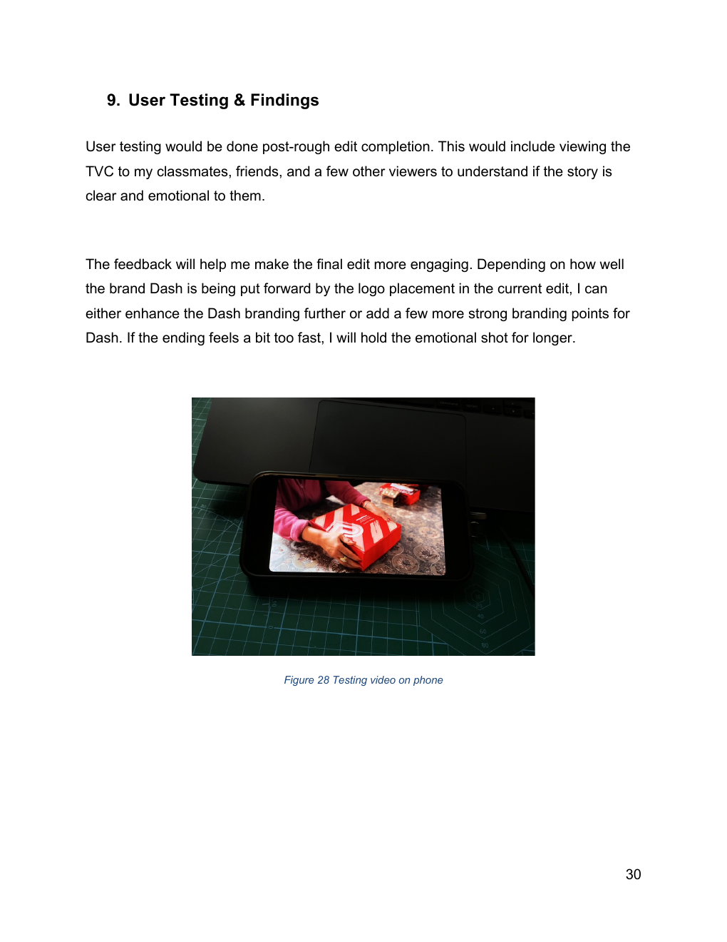
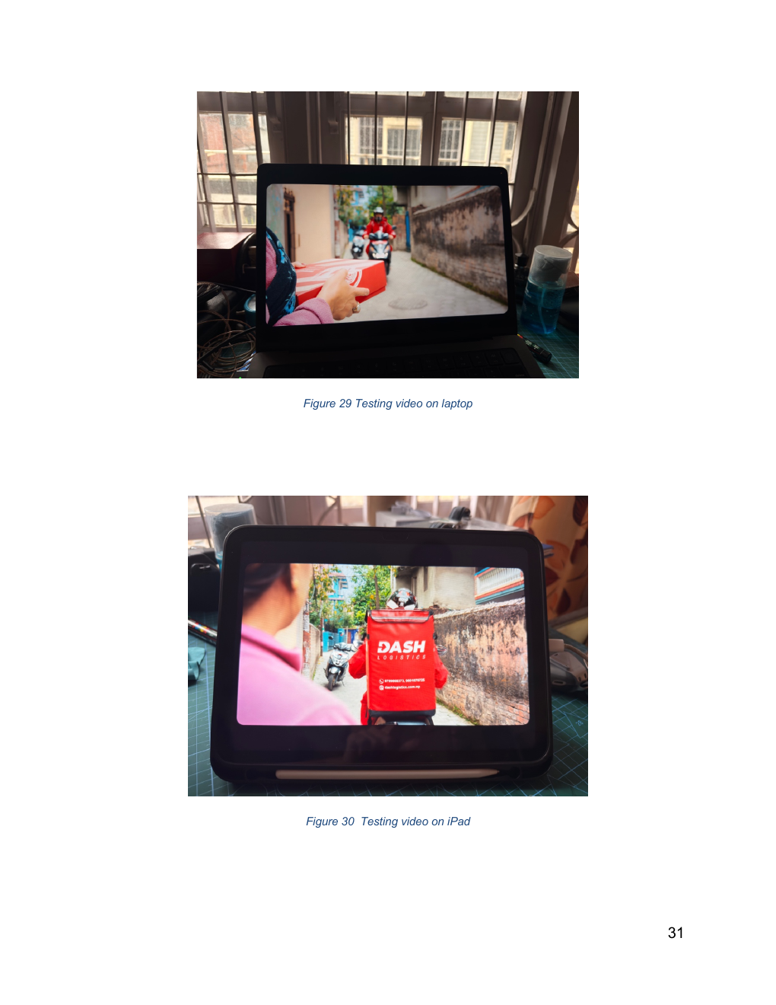
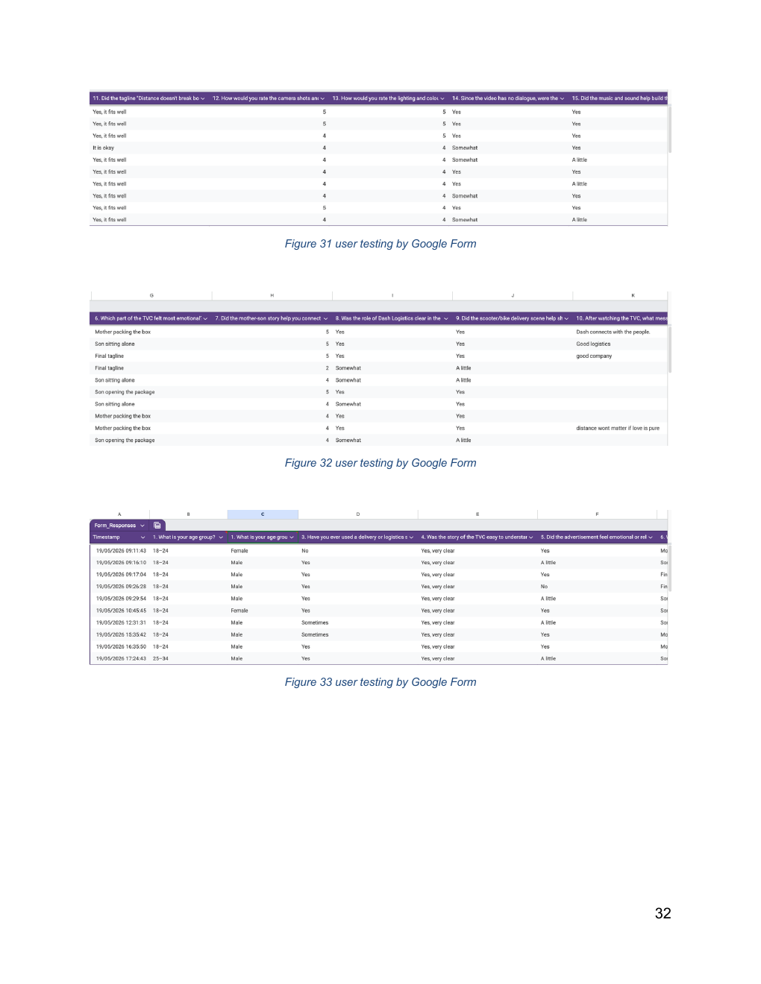
User Testing & Findings
Feedback checked story clarity, emotion, brand visibility and technical quality.
Tested on phone, laptop and iPad to check viewing experience
Google Form used for audience feedback
Questions focused on story clarity, no-dialogue understanding, music, colour and Dash branding
Feedback helped judge whether the final message was memorable
SM6P07NI Digital Media Project • Dash Logistics TVC
12

Slide 13
Reflection & Critical Analysis
What worked, what changed and what I learned.
Worked well
Challenge
Improvement
Emotional no-dialogue story
Practical production limits
More controlled sound & timing
The mother-son package idea was clear, simple and relatable.
Locations, scooters and moving shots had to be managed with available resources.
Final emotional shot and sound levels can be refined further if more time is available.
Learning
Full TVC workflow
I learned how to move from idea to research, script, storyboard, production, editing, testing and final export.
SM6P07NI Digital Media Project • Dash Logistics TVC
13

Slide 14
Thank You
Questions?
Distance doesn’t break bonds.
Dash delivers what matters.
Binay Bhattarai • 23048277
SM6P07NI Digital Media Project • Dash Logistics TVC
14

